Slide 1
Data Link Layer

Slide 2
Data Link Layer design issues:
DLL uses the services of the physical layer to send and receive bits over communication channels.
Functions:
Providing a well defined service interface to the network layer.
Dealing with transmission errors.
Regulating the flow of data so that slow receivers are not swamped by fast senders
To accomplish these goals, the DLL takes the pkts it gets from NL and encapsulates them into frames for transmission.

Slide 3
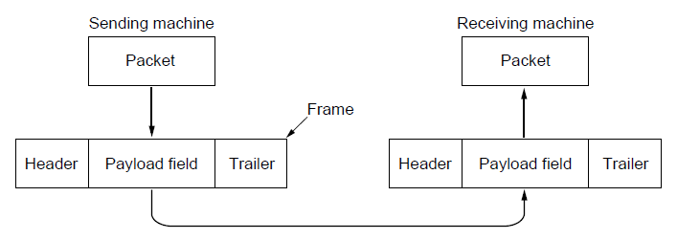
Frames:

Slide 4
Services Provided to the Network Layer
Principal Service Function of the data link layer is to transfer the data from the network layer on the source machine to the network layer on the destination machine.
Process in the network layer that hands some bits to the data link layer for transmission.
Job of data link layer is to transmit the bits to the destination machine so they can be handed over to the network layer there (see figure in the next slide).

Slide 5

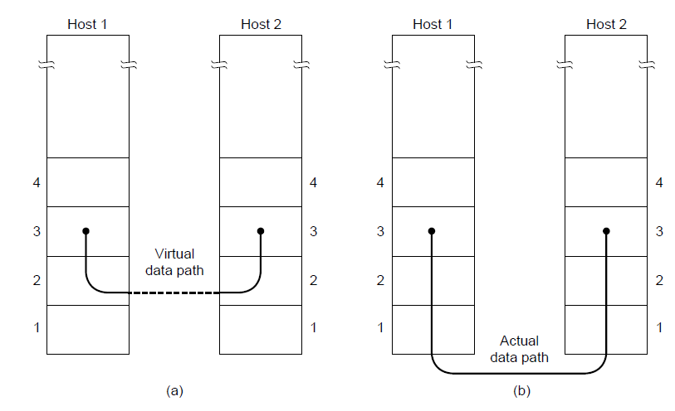
(a) Virtual communication. (b) Actual communication.

Slide 6
Possible Services Offered
DLL can be designed to offer various services. The actual services that are offered vary from protocol to protocol. Three reasonable possibilities that are considered are as:
Unacknowledged connectionless service.
Acknowledged connectionless service.
Acknowledged connection-oriented service.

Slide 7
Unacknowledged Connectionless Service
It consists of having the source machine send independent frames to the destination machine without having the destination machine acknowledge them.
No logical connection is established.
If a frame is lost due to noise, no attempt is made to detect the loss or recover from it in dll.
Example: Ethernet, Voice over IP, etc. in all the communication channel were real time operation is more important that quality of transmission.
(Suited for low error rate networks or for fault tolerant applications)
Notes:
Recovery is left to higher layer.
Late data are worse than bad data.[real time traffic]

Slide 8
Acknowledged Connectionless Service
Each frame send by the Data Link layer is acknowledged (still no logical connection) and the sender knows if a specific frame has been received or lost.
Typically the protocol uses a specific time period that if has passed without getting acknowledgment it will re-send the frame.
This service is useful over an unreliable channel such as wireless system(e.g., 802.11 WiFi).
Providing ack in dll is just an optimization, never a requirement.
On reliable channels, such as fiber, the overhead of a dll may be unnecessary, but on (inherently unreliable) wireless channels it is well worth the cost.

Slide 9
Acknowledged Connection Oriented Service
The most sophisticated service the dll can provide to network layer is conn oriented service.
Source and Destination establish a connection first.
Each frame sent is numbered
Data link layer guarantees that each frame sent is indeed received.
It guarantees that each frame is received only once and that all frames are received in the correct order.
Examples:
Satellite channel communication,
Long-distance telephone communication, etc.

Slide 10
Acknowledged Connection Oriented Service
Three distinct phases:
Connection is established by having both side initialize variables and counters needed to keep track of which frames have been received and which ones have not.
One or more frames are transmitted.
Finally, the connection is released – freeing up the variables, buffers, and other resources used to maintain the connection.

Slide 11
Framing
To provide service to the network layer the data link layer must use the service provided to it by physical layer.
Stream of data bits provided to data link layer is not guaranteed to be without errors.
Errors could be:
Number of received bits does not match number of transmitted bits (deletion or insertion)
It is up to data link layer to detect the error and correct the errors if necessary.

Slide 12
Framing
Transmission of the data link layer starts with breaking up the bit stream
into discrete frames
Computation of a checksum for each frame, and
Include the checksum into the frame before it is transmitted.
Receiver computes its checksum error for a receiving frame and if it is different from the checksum that is being transmitted will have to deal with the error.
Framing is more difficult than one could think!

Slide 13
Framing Methods
Byte count.
Flag bytes with byte stuffing.
Flag bits with bit stuffing.
Physical layer coding violations.

Slide 14
Byte Count Framing Method
It uses a field in the header to specify the number of bytes in the frame.
Once the header information is being received it will be used to determine end of the frame.
See figure in the next slide:
Trouble with this algorithm is that when the count is incorrectly received the destination will get out of synch with transmission.
Destination may be able to detect that the frame is in error but it does not have a means (in this algorithm) how to correct it.

Slide 15
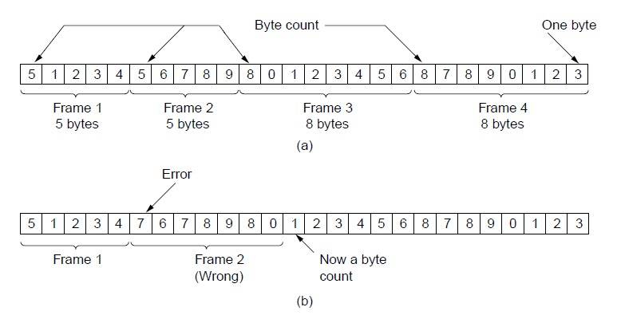
Byte Count
A byte stream. (a) Without errors. (b) With one error.

Slide 16
Flag Bytes with Byte Stuffing Framing Method
This methods gets around the boundary detection of the frame by having each appended by the frame start and frame end special bytes.
Often the same byte, called flag byte, is used as both staring and ending delimiter.
Two consecutive flag bytes indicate the end of one frame and start of next frame
Thus, if the rec ever losses the syn it can just search the two flag bytes to find end and start.
If the actual data contains a byte that is identical to the FLAG byte (e.g., picture, data stream, etc.) the convention that can be used is to have escape character inserted just before the “FLAG” character.

Slide 17
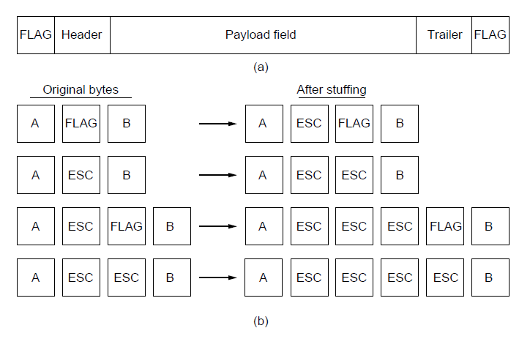

Framing (2)
A frame delimited by flag bytes.
Four examples of byte sequences before and after byte stuffing.
Notes:
Used in PPP

Slide 18
Flag Byte with Bit Stuffing Framing Method
This methods achieves the same thing as Byte Stuffing method by using arbitrary no number of bits.
It was developed for High-level Data Link Control (HDLC) protocol.
Each frames begins and ends with a special bit pattern:
01111110 or 0x7E <- Flag Byte
Whenever the sender’s data link layer encounters five consecutive 1s in the data it automatically stuffs a 0 bit into the outgoing bit stream.
USB uses bit stuffing.

Slide 19
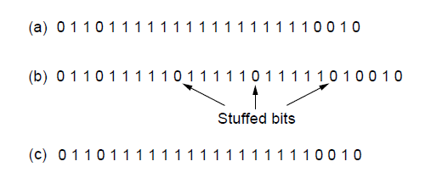
Framing (3)
Bit stuffing. (a) The original data. (b) The data as they appear on
the line. (c) The data as they are stored in the receiver’s memory after destuffing.

Slide 20
Framing
Many data link protocols use a combination of presented methods for safety. For example in Ethernet and 802.11 each frame begin with a well-defined pattern called a preamble.
Preamble is typically 72 bits long.
It is then followed by a length field.

Slide 21
Error Control
After solving the marking of the frame with start and end the data link layer has to handle eventual errors in transmission or detection.
Ensuring that all frames are delivered to the network layer at the destination and in proper order.
Unacknowledged connectionless service: it is OK for the sender to output frames regardless of its reception.
Reliable connection-oriented service: it is NOT OK.

Slide 22
Error Control
Reliable connection-oriented service usually will provide a sender with some feedback about what is happening at the other end of the line.
Receiver Sends Back Special Control Frames.
If the Sender Receives positive Acknowledgment it will know that the frame has arrived safely.
Timer and Frame Sequence Number for the Sender is Necessary to handle the case when there is no response (positive or negative) from the Receiver .

Slide 23
Flow Control
Important Design issue for the cases when the sender is running on a fast powerful computer and receiver is running on a slow low-end machine.
Two approaches:
Feedback-based flow control
Rate-based flow control
Notes:
Rate based are only seen as part of transport layer
Feedback are seen at both LL and higher layers.

Slide 24
Feedback-based Flow Control
Receiver sends back information to the sender giving it permission to send more data, or
Telling sender how receiver is doing.
Built in mechanism that limits the rate at which sender may transmit data, without the need for feedback from the receiver.
Rate-based Flow Control

Slide 25
Error Detection and Correction
Two basic strategies to deal with errors:
Include enough redundant information to enable the receiver to deduce what the transmitted data must have been. Error correcting codes. (FEC)
Include only enough redundancy to allow the receiver to deduce that an error has occurred (but not which error). Error detecting codes.

Slide 27
Elementary Data Link Protocols (1)
Utopian(Unrestricted) Simplex Protocol
Simplex Stop-and-Wait Protocol
Error-Free Channel
Simplex Stop-and-Wait Protocol
Noisy Channel

Slide 28
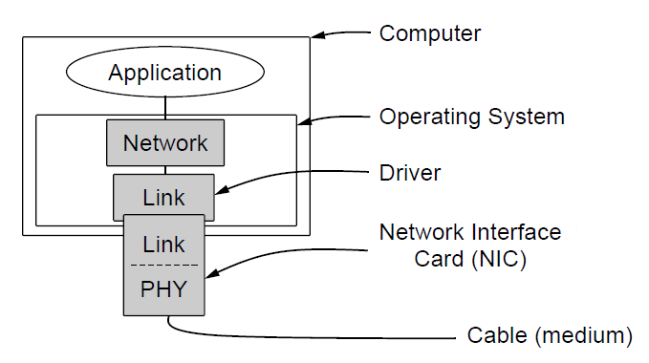
Elementary Data Link Protocols (2)
Implementation of the physical, data link, and network layers.

Slide 29
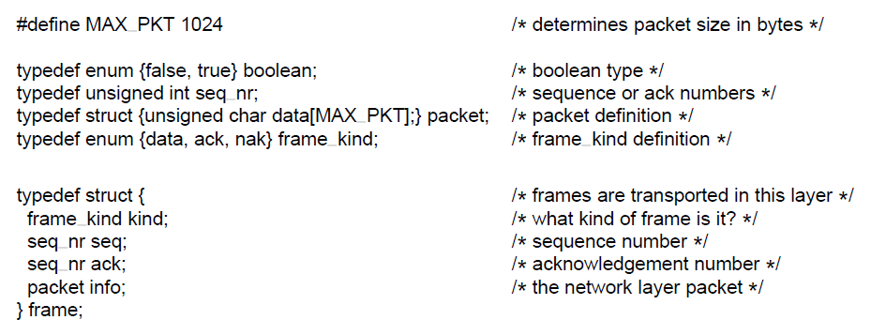
Elementary Data Link Protocols (3)
Some definitions needed in the protocols to follow. These definitions are located in the file protocol.h.

Slide 30
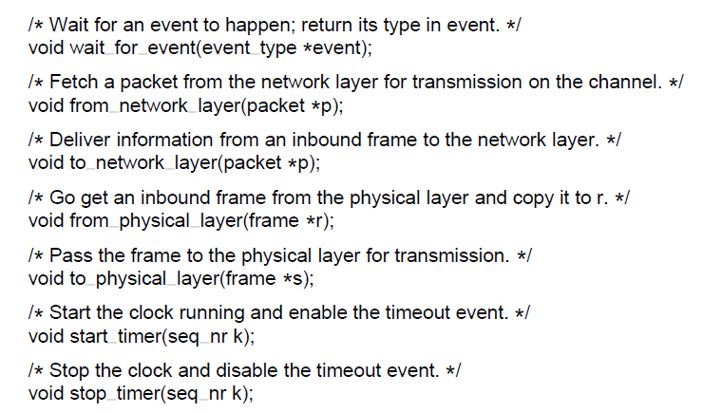
Elementary Data Link Protocols
Some definitions needed in the protocols to follow. These definitions are located in the file protocol.h.

Slide 31
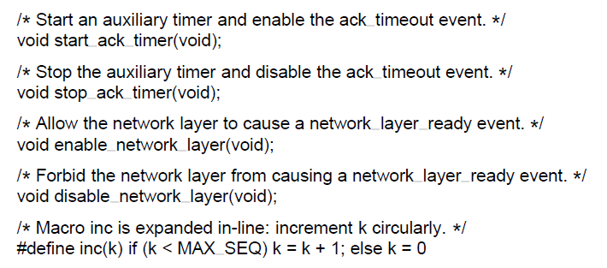
Elementary Data Link Protocols (5)

Slide 32
Utopian Simplex Protocol / Unrestricted Simplex Protocol
Very simple protocol
Data transmission in one direction only (either sender or receiver)
Tx and Rx always ready
Infinite buffer space available
Communication Channel is error free

Slide 33
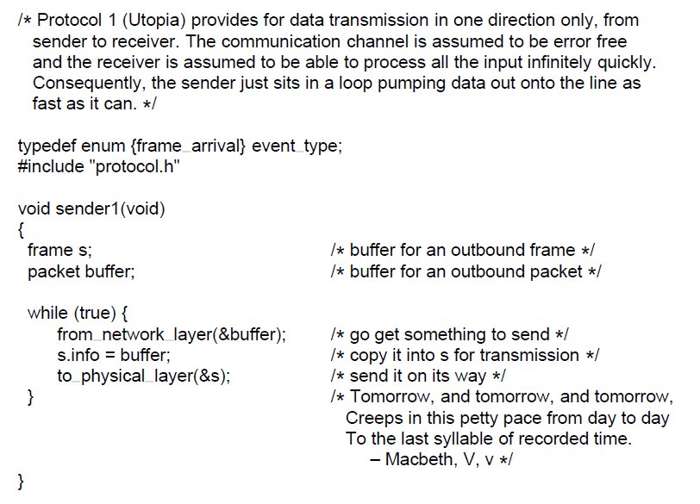
Utopian Simplex Protocol
A utopian simplex protocol.

Slide 34
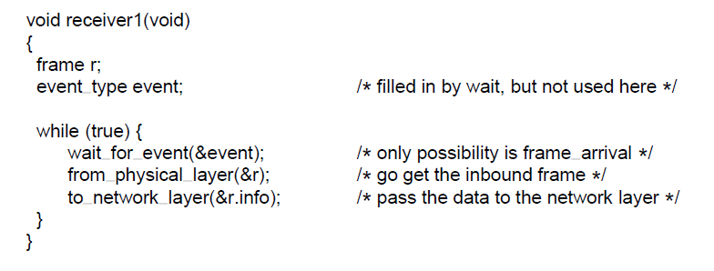
Utopian Simplex Protocol (2)
A utopian simplex protocol.

Slide 35
Simplex Stop-and-Wait Protocol for an Error-Free Channel
Data traffic is simplex
finite buffer space available
Communication Channel is error free
Prevent the fast sender, sender has to wait for acknowledgement before proceeding to send the next packet.

Slide 36
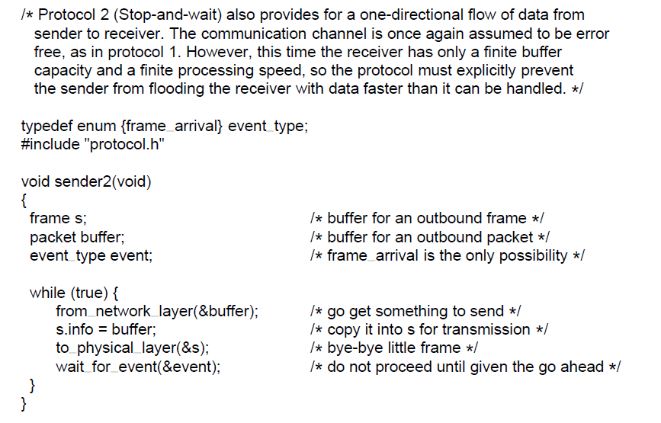
Simplex Stop-and-Wait Protocol for an Error-Free Channel
. . .
A simplex stop-and-wait protocol.

Slide 37
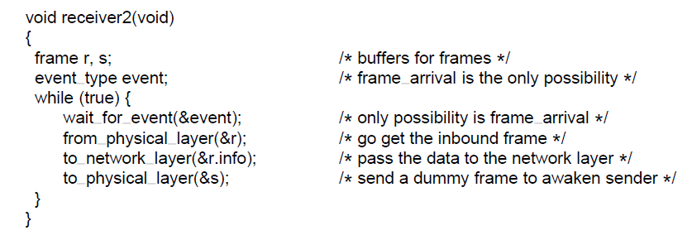

Slide 38
Simplex Stop-and-Wait Protocol for a Noisy Channel
Data transmission in one direction only
finite buffer space available
Communication Channel is not error free
Sender sends a frame
Receiver sends ack if frame is received correctly otherwise no ack in case of damaged frame
Use of timer. If timer runs out, resend the frame

Slide 39
Ref fig;
Protocols in which the sender waits for a positive ack before advancing to the next data item are often called ARQ. (Automatic Repeat reQuest) or PAR( Positive Ack with Retransmission)

Slide 40
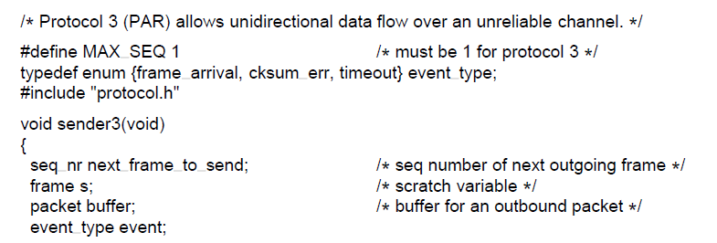
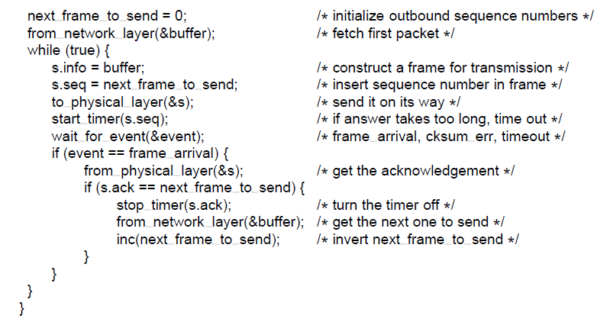

Slide 41
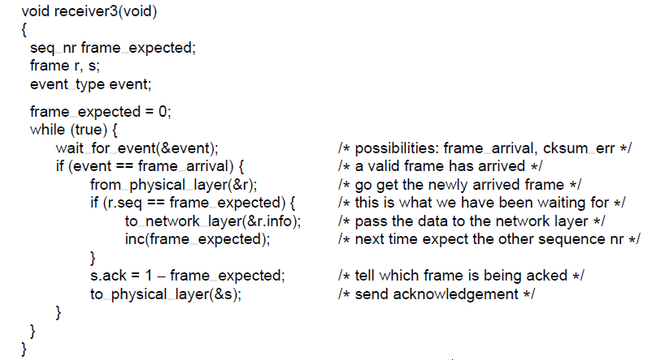

Slide 42
Sliding Window Protocol
Full duplex
Each link has forward(data) and reverse(ack) ch.
In both cases, the capacity of reverse is wasted.
1. Data from A->B is intermixed with ack from A->B.(kind field in header).
2 . piggybacking
3 . Complication: how long should dll wait for piggybacking the ack?
4. Time period.
Window: sender and receiver window.

Slide 43
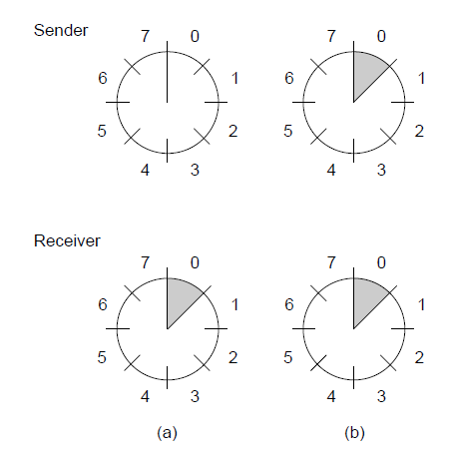
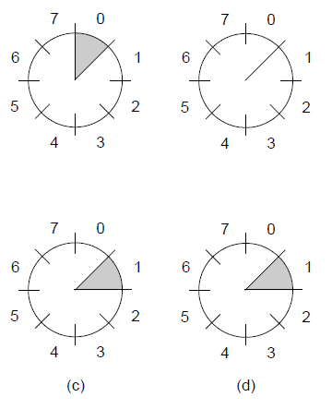
Sliding Window Protocols

Slide 44
Sliding window (1-bit )
Data transmission in both direction ie full duplex communication
finite buffer space available
Communication Channel is not error free
Use of timer
Sender sends a frame
Receiver sends ack along with its if frame

Slide 45
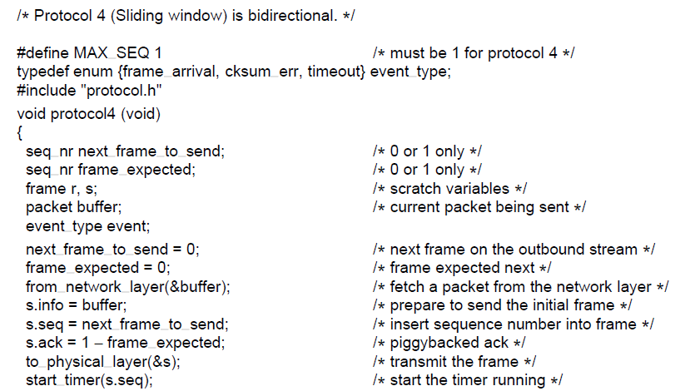

Slide 46
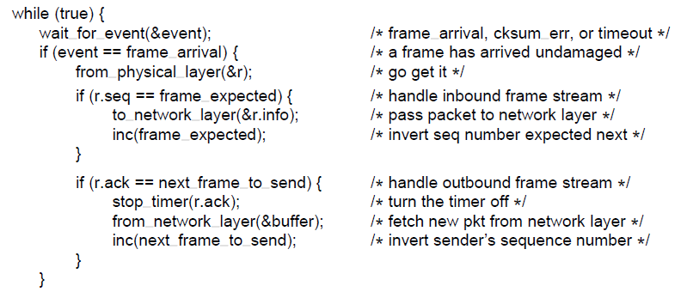
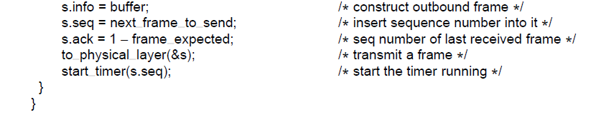

Slide 47
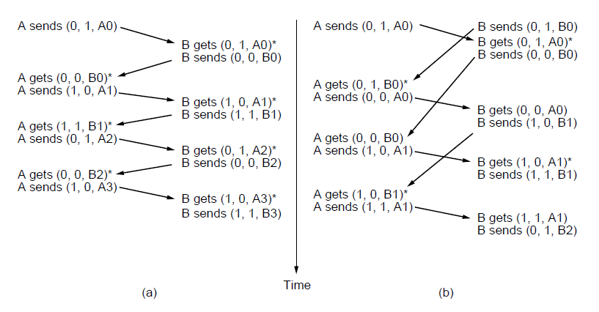
(seq no, ack, frame no)
Receiver sends ack as a seq no of frame received.
Normal Scenario: Timers are synchronized
B has waited till the first frame from sender A to receive to synchronize the ack
Abnormal Scenario: Timers are premature timeouts
Both A and B started sending their frames at the same time. A’s time out interval is too little. Retransmission of duplicate frames has happened.

Slide 49
Go-Back and Selective Repeat
Transmission time for frame and ack are negligible (This assumption is sometimes false)
In these situations the long RTT can have more important implications for the eff of BW.
Example:
Combination of long transmit time, high BW, short frame length is disastrous in terms of eff.

Slide 50
Problem: Waiting for an ack before sending another frame.
Soln: Allow sending w frames before blocking , instead of one.
To find an appropriate value of w: bw*delay product.
W=2B*D+1
Example:

Slide 51
Pipelining
The technique of keeping multiple frames in flight is an eg of pipelining.
Pipelining frames over an unreliable comm ch is a concern.
What if frame in the middle is damaged?
(rememder rec dll is obligated to handle pkt to nl in seq)
Two options:
Go-Back-N
Selective Repeat

Slide 52
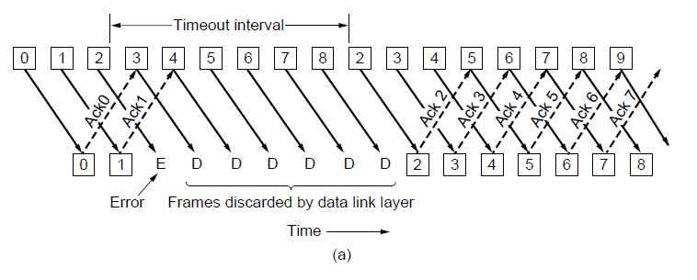
Pipelining and error recovery. Effect of an error when
(a) receiver’s window size is 1

Slide 53
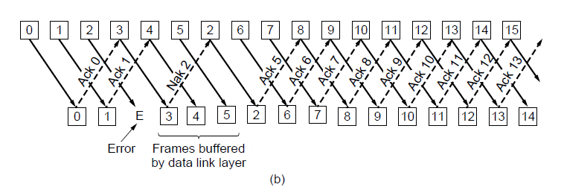
Pipelining and error recovery. Effect of an error when
(b) receiver’s window size is large.

Slide 54
Go-Back-N
Discards all subsequent frames, sending no ack for the discarded frames.
Rec window size =1 (Dll refuses to accept any frame except the nxt one it must give to NL)
If no ack, Sender time outs and retransmits all unack frames in order.
This approach can waste a lot of BW if the err rate is high.

Slide 55
Selective Repeat
Handles error when frames are pipelined.
Bad frames: discard
Good frames: accepted and buffered.
When sender time outs, only the unack frame is retransmitted.
When that frame arrives correctly, rec can deliver all frames ( stored in buffer ) in order to NL.
These two alternate approaches are trade-off between eff use of BW and DLL buffer space.

Slide 56
High-level Data Link Control protocol: HDLC

Slide 57
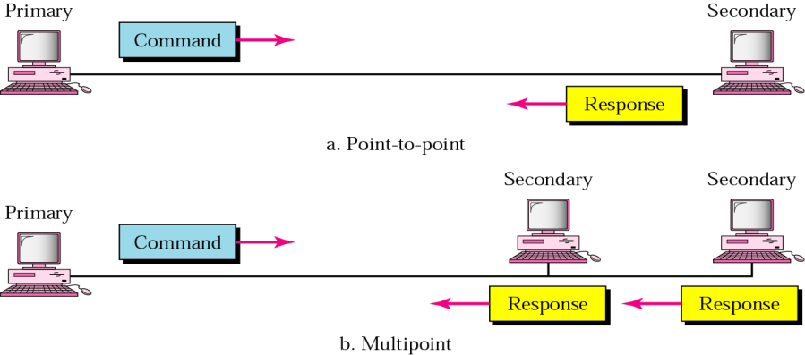
HDLC Link Configurations and transfer modes
Normal Response Mode (NRM)
Unbalanced configuration: One primary and many secondary stations. Primary station sends cmds; secondary can only respond. NRM is used for both p2p and multipoint links.

Slide 58
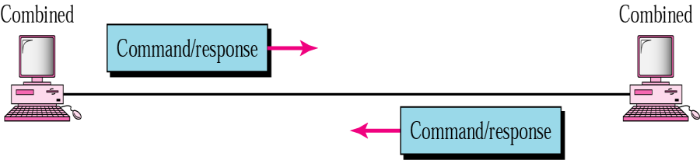
2. Asynchronous Balanced Mode (ABM)
Balanced configuration:
Either station may initiate transmission without receiving permission
In ABM the link is point-to-point

Slide 59
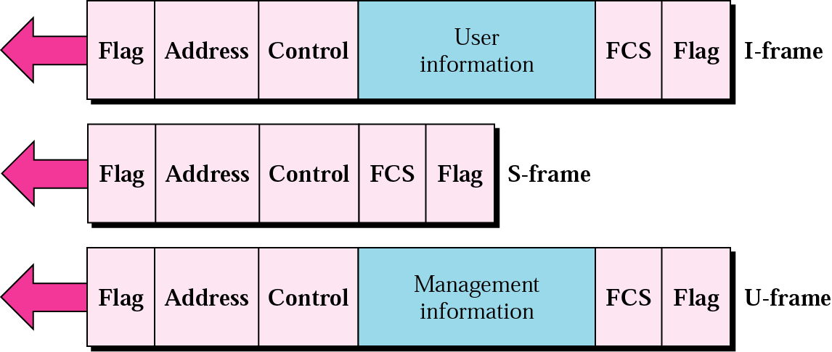
HDLC frame types
1. I-Frame: Information frames
2. S- Frame: Supervisory frames
3. U-Frame: Unnumbered frames

Slide 60
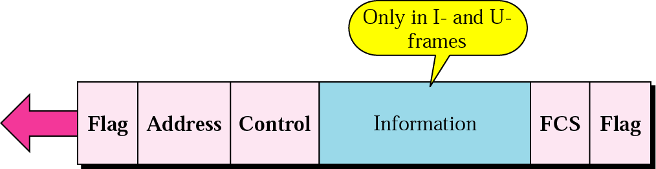
HDLC frame
Flag: 8-bit ; 01111110 that identifies the beginning and end of the frame.
FCS: frame check sequence is error detection field
Address: contain the address of the secondary station . It can be one byte or more . If the address is more than one bytes , all bytes end with zero except the last byte ends with one. Ending each intermediate byte with 0 indicates to the receiver. If created by primary, its “to” address; if created by secondary, its “from” address
Control Field : determine the type of frame and used for flow control and error control.

Slide 61
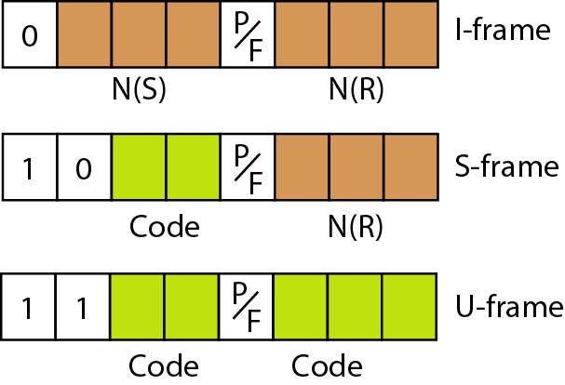

Slide 62
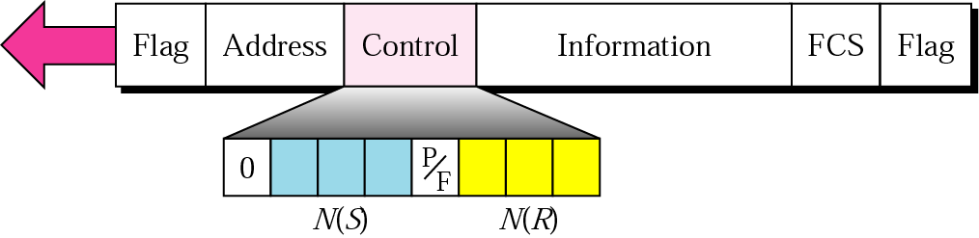
I-frame
Information: contains the user’s information.
Control field:
The first bit (0) defines the frame type (I-Frame)
N(S): defines the sequence number of the frame.
N(R) : Acknowledgment number when piggybacking is used.
P/F: set to 1 with dual purpose:
Poll: frame sent by the primary station (the address field contains the address of the receiver).
Final: frame sent by secondary station (the address field contain the address of the sender).

Slide 63
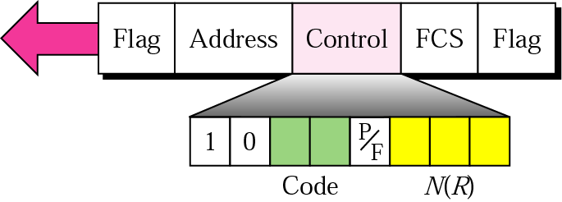
S-frame
The Code field define four types of S-frames:
For flow and error control
1. Receiver ready (RR) (00): receiver ready to accept more I-frames
2. Receiver not ready (RNR)(10): receiver not ready to accept more I frames [flow control by asking the sender to slow down]
3. Reject (REJ)(01): This is NAK Frame that can be used in Go-Back-N to improve the efficiency. The N(R) is –ve ack.
4. Selective Reject (SREJ)(11): NAK frame used in Selective repeat. The N(R) is –ve ack.

Slide 64
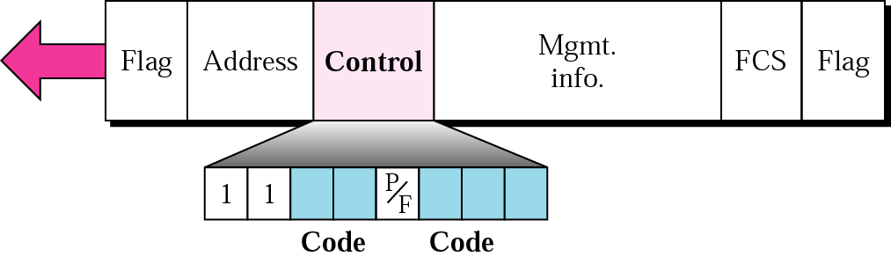
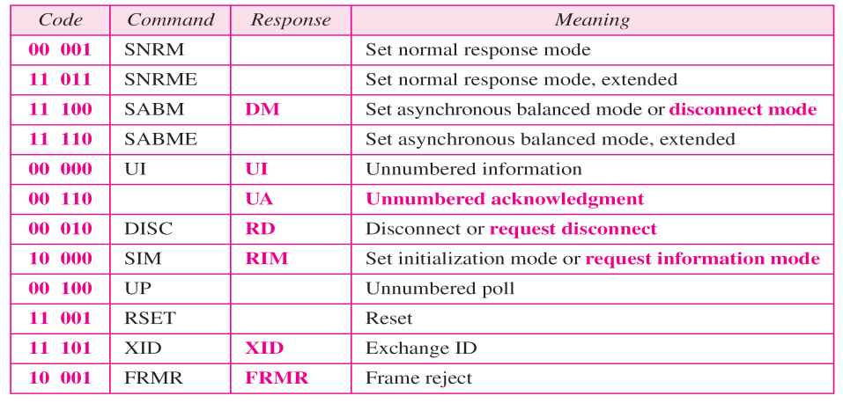
U-frame
These frames are used to exchange session mgmt and control info between connected devices. Info -> mgmt info.

Slide 65
PPP Point to Point Protocol
Used for router-to-router and user-to-ISP traffic.
Its byte oriented protocol.
PPP uses two protocols viz. LCP and NCP. LCP takes care of establishment of link. NCP makes sure that IP and other protocols are transmitted across the PPP link.
PPP supports two authentication protocols viz. PAP (Password Authentication Protocol) and CHAP (Challenge Handshake Authentication Protocol) . • PAP uses simple 2 way handshake used at initial link establishment phase. It is not strong authentication protocol as passwords are sent across in clear text. • CHAP provides better authentication as it uses 3-way handshake mechanism.

Slide 66
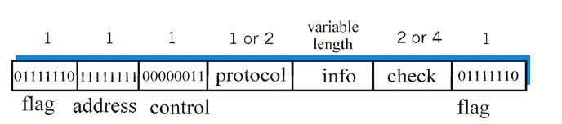

Slide 67
Divekar Sanika
3:23 PM
80
Sonawane Nitesh
3:23 PM
88
Jadhav Sanket
3:23 PM
83
Jaisinghani Amit
3:24 PM
85
Zaware Samruddhi
3:24 PM
89
Pacharne Tejas
3:24 PM
82
DESHMUKH JAYESH
3:24 PM
87
87
Zaware Samruddhi
1:18 PM
89
Jaisinghani Amit
1:18 PM
85
Sonawane Nitesh
1:18 PM
88
Divekar Sanika
1:18 PM
80
Pacharne Tejas
1:18 PM
82
Jadhav Sanket
1:18 PM
83
DESHMUKH JAYESH
1:18 PM
87

Slide 68
08-02-2024
Sy it-A
Absent:- 1 4 5 10 11 12 14 22 27 37 41 43 49 50 52 54 57 58 59 60 66 67 70

